Slide 1
Socket Programming 1
Computer Networks, Monsoon 2024
TA: Priyash and Akanksha

Slide 2
What will you learn?
Build single-threaded UDP server & client using Linux socket APIs
Build multi-threaded UDP server & client using Linux socket APIs
Error-handling & debugging while using Linux socket APIs
Build single-threaded TCP server & client using Linux socket APIs
Build multi-threaded TCP server & client using Linux socket APIs

Slide 3
Socket Programming

Slide 4
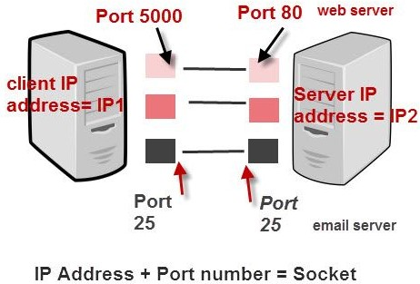

What is a socket?
For communicating between processes of same machine or different machines
Multiple Ports
Electric socket

Slide 5
What is a socket?
Linux socket API returns a socket file descriptor.
You can read & write bytes to socket using the socket file descriptor.
It is analogous to reading and writing files on filesystem using file descriptor. But instead of writing those bytes to a file, the operating system send them to another computer across the network.

Slide 6
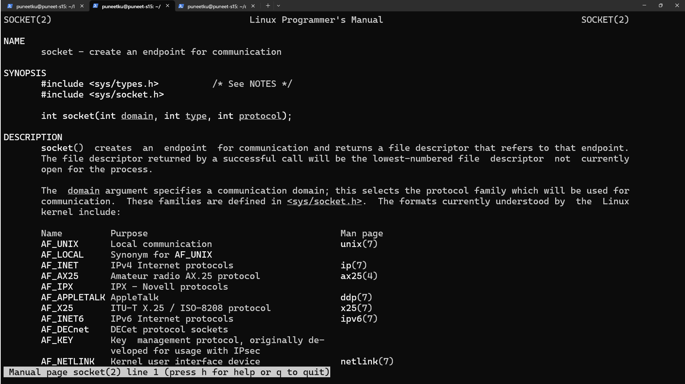
man socket

Slide 7
Creating UDP Socket
For this, we call the socket function, specifying the type of communication protocol.
#include <sys/socket.h>
int sockfd = socket(domain, type, protocol);
domain: Protocol Family. We will use “AF_INET” for IPv4
type: Type of Socket. We will use “SOCK_DGRAM” for UDP
protocol: Protocol value for Internet Protocol(IP), which is 0.

Slide 8
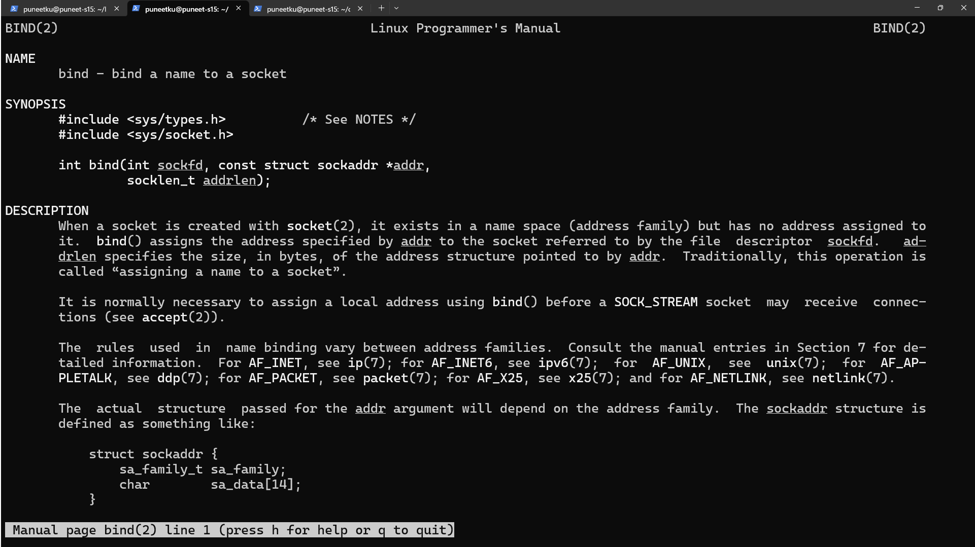
man bind

Slide 9
Binding the socket at server to an address
The bind() assigns a local protocol address to a socket. With the Internet protocols, the address is the combination of an IPv4 or IPv6 address (32-bit or 128-bit) address along with a 16 bit TCP port number.
#include <sys/socket.h>
int bind(int sockfd, const struct sockaddr *servaddr, socklen_t addrlen);
where, sockfd is the socket descriptor, sockaddr is a pointer to a protocol-speciﬁc address and addrlen is the size of the address structure.

Slide 10
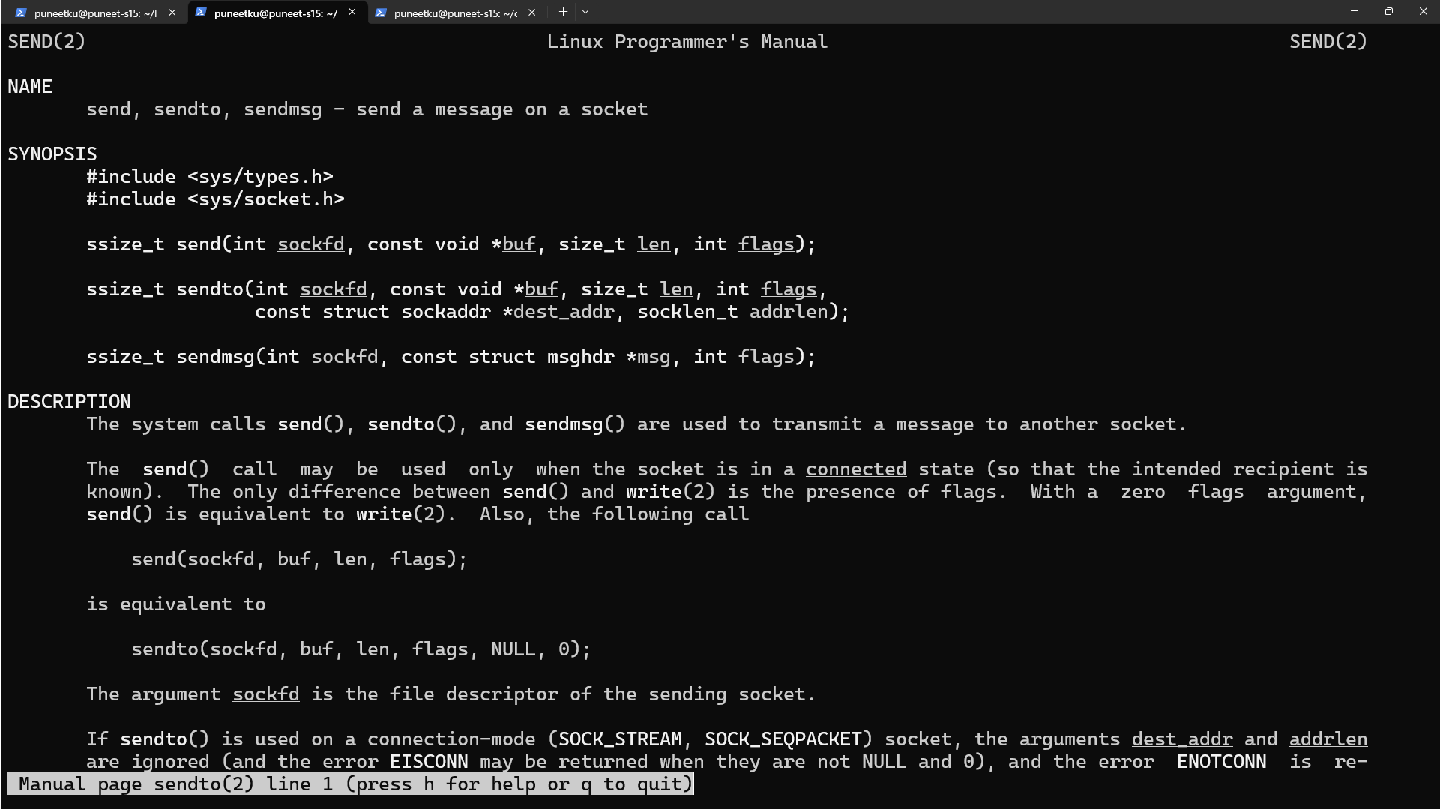
man sendto

Slide 11
Send Data
Since a socket endpoint is represented as a ﬁle descriptor, we can use read and write to communicate with a socket.
#include <sys/socket.h>
ssize_t send(int sockfd, const void *buf, size_t nbytes, int flags, const struct sockaddr *dest_addr, socklen_t addrlen);
It is mandatory to send destination address with each message in UDP. That’s not the case in TCP.
Flags modify behavior of send operation such as blocking vs non-blocking I/O etc. We will use 0 in our demo.

Slide 12
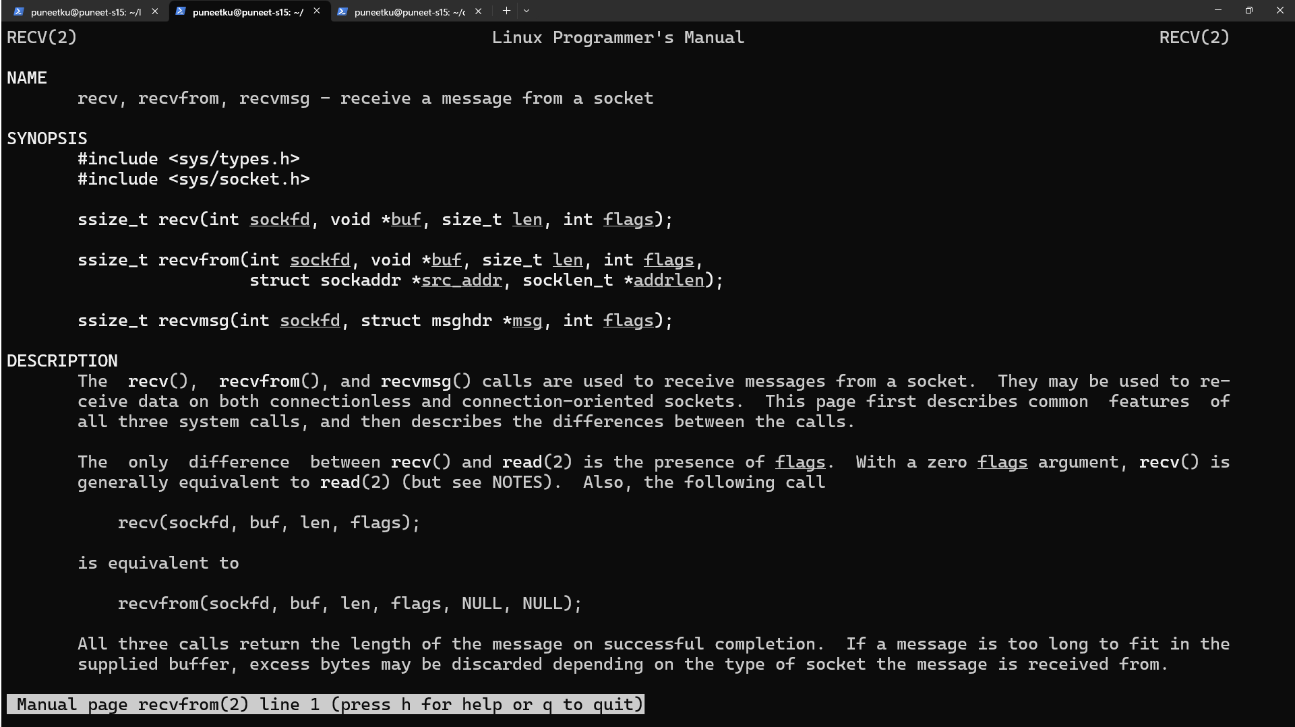
man recvfrom

Slide 13
Receive Data
The recv() function is similar to read(), but allows to specify some options to control how the data are received
#include <sys/socket.h>
ssize_t recvfrom(int sockfd, void *buf, size_t nbytes, int flags, struct sockaddr *src_addr, socklen_t *addrlen);
recvfrom operation saves source address in “src_addr”. It is required to send response to the client later on.

Slide 14
Receive Data
The recv() function is similar to read(), but allows to specify some options to control how the data are received
#include <sys/socket.h>
ssize_t recvfrom(int sockfd, void *buf, size_t nbytes, int flags, struct sockaddr *src_addr, socklen_t *addrlen);
Flags modify behavior of receive operation. We will use “MSG_WAITALL” in our demo.

Slide 15
Error Handling
APIs such as socket,bind, sendto, recvfrom return “-1” if they fail.
Error code is set in a global variable called “errno”.
You can print a descriptive error using “strerror(errno)”.

Slide 16
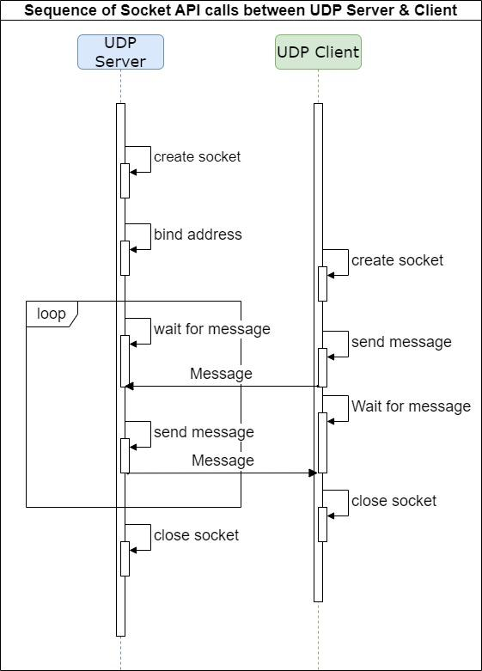

Slide 17
Demo
Demo UDP Server & Client
Use errno & debugger to troubleshoot a bug

Slide 18
Why is UDP challenging to use?

Slide 19
Why is UDP challenging to use?
Unreliable because some bytes may be lost during transmission
Some bytes may be delivered out-of-order

Slide 20
TCP vs UDP
Connection = “friendship”
TCP | UDP
Connection oriented | Connectionless
Reliable - recovery is possible | Unreliable - no recovery mechanism
Eg: Internet communication | Eg: DNS

Slide 21
TCP Stream Socket
Reliable
Handles packet loss.
In-order delivery.
Requires acknowledgement.
Has Congestion control.
Similar to telephone connection.

Slide 22
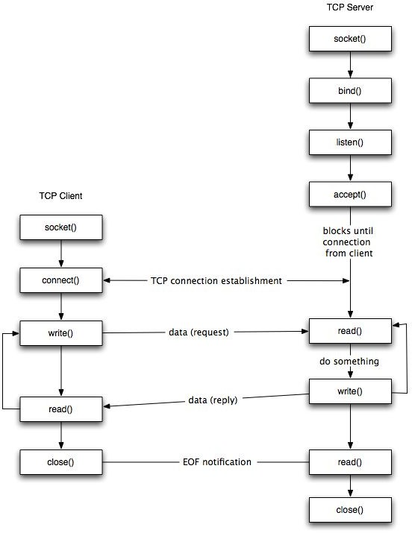
TCP Client-Server Model

Slide 23
Creating TCP Socket
For this, we call the socket function, specifying the type of communication protocol.
#include <sys/socket.h>
int sockfd = socket(domain, type, protocol);
domain: Protocol Family
type: Type of Socket (SOCK_STREAM or SOCK_DGRAM or SOCK_RAW) protocol: Protocol value for Internet Protocol(IP), which is 0.

Slide 24
Binding the socket to an address
The bind() assigns a local protocol address to a socket. With the Internet protocols, the address is the combination of an IPv4 or IPv6 address (32-bit or 128-bit) address along with a 16 bit TCP port number.
#include <sys/socket.h>
int bind(int sockfd, const struct sockaddr *servaddr, socklen_t addrlen);
where, sockfd is the socket descriptor, sockaddr is a pointer to a protocol-speciﬁc address and addrlen is the size of the address structure.

Slide 25
Listen for connections
The listen() function converts an unconnected socket into a passive socket, indicating that the kernel should accept incoming connection requests directed to this socket.
#include <sys/socket.h>
int listen(int sockfd, int backlog);
where sockfd is the socket descriptor and backlog is the maximum number of connections the kernel should queue for this socket.

Slide 26
Accept a connection
The accept() is used to retrieve a connect request and convert that into a request.
#include <sys/socket.h>
int accept(int sockfd, struct sockaddr *cliaddr, socklen_t
*addrlen);
where sockfd is the ﬁle descriptor that is connected to the client that called the connect(). The cliaddr and addrlen arguments are used to return the protocol address of the client.
DOES NOT NEED CLIENT IP AND PORT A PRIORI

Slide 27
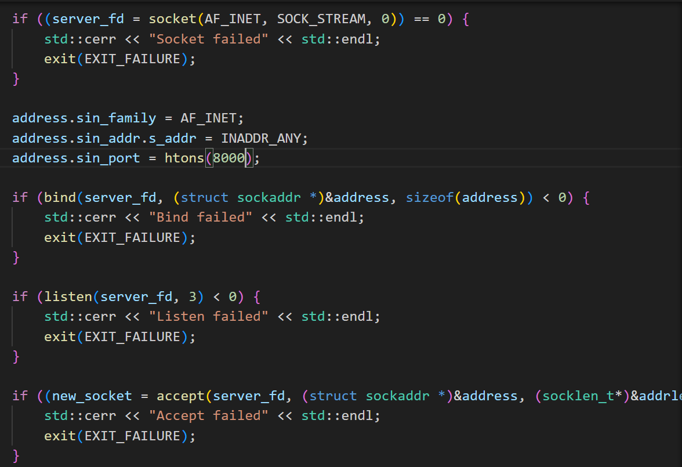
AF_INET - IP FOR INTERNET COMMUNICATION
SOCK_STREAM - TCP (STREAM) DATA
SERVER_FD - socket descriptor,
Address and port , address length
Socket descriptor and max no of connections
socket descriptor,
CLIENT Address and port , CLIENT address length

Slide 28
Send Data
Since a socket endpoint is represented as a ﬁle descriptor, we can use read and write to communicate with a socket as long as it is connected.
#include <sys/socket.h>
ssize_t send(int sockfd, const void *buf, size_t nbytes, int flags);

Slide 29
Create Connection
The connect() function is used by a TCP client to establish a connection with a TCP server.
#include <sys/socket.h>
int connect (int sockfd, const struct sockaddr *servaddr, socklen_t addrlen);
where sockfd is the socket descriptor returned by the socket function.

Slide 30
Receive Data
The recv() function is similar to read(), but allows to specify some options to control how the data are received
#include <sys/socket.h>
ssize_t recv(int sockfd, void *buf, size_t nbytes, int flags);

Slide 31
Close Socket
The normal close() function is used to close a socket and terminate a TCP socket.
#include <unistd.h> int close(int sockfd);
TIME_WAIT: A time period that ensures that any delayed or out-of-order packets related to the closed connection are correctly handled before the socket is fully released and made available for reuse

Slide 32
How would you implement a server?

Slide 33
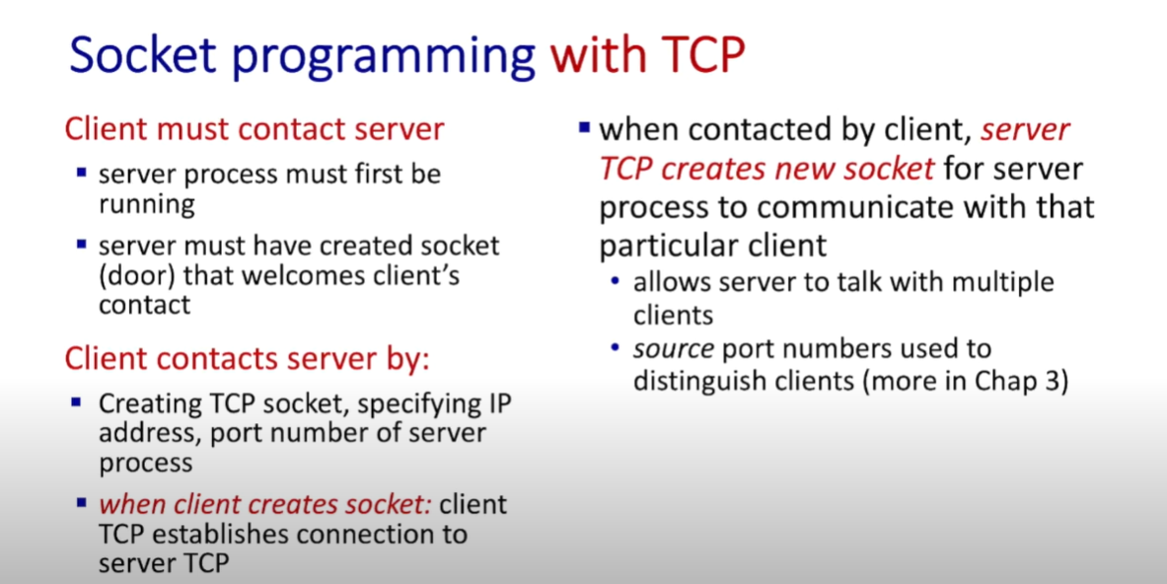

Slide 34
Single threaded TCP server
Connection Request
Listening Socket
Server Process
Client 1
IP:Port

Slide 35
Single threaded TCP server
Server Process
Client 1
Connected Socket
Connection

Slide 36
Multi threaded TCP server
Connection Request
Listening Socket
Server Process
Client 1
IP:Port

Slide 37
Multi threaded TCP server
Listening Socket
Server Process
Client 1
Connection
Connected Socket
^{Thread}

Slide 38
Multi threaded TCP server
Connection
Client 2
Connected Socket
^{Thread}
Listening Socket
Server Process
Client 1
Connected Socket
^{Thread}
Connection
All the sockets are associated with a single port in the server process.

Slide 39
Multi threaded TCP server
Connection Request
Listening Socket
Server Process
Client 2
IP:Port
Connected Socket
^{Thread}
Client 1
Connection

Slide 40
TCP DEMO
Github link: https://github.com/AkankshaSingal8/socket_programming.git

Slide 41
https://www.youtube.com/watch?v=_iHMMo7SDfQ&t=640s
Video Lecture on Socket Programming by Prof. Jim Kurose

Slide 42
References
LibC wrapper on socket system call
LibC wrapper on bind system call
LibC wrapper on listen system call
LibC wrapper on accept system call
LibC wrapper on connect system call
Concurrent Server
Linux Programming Interface

